Slide 1
Reaction-diffusion equations with spatially distributed hysteresis
Pavel Gurevich, Sergey Tikhomirov
Free University of Berlin
Roman Shamin
Shirshov Institute of Oceanology, RAS, Moscow
Wittenberg, December 12, 2011

Slide 2
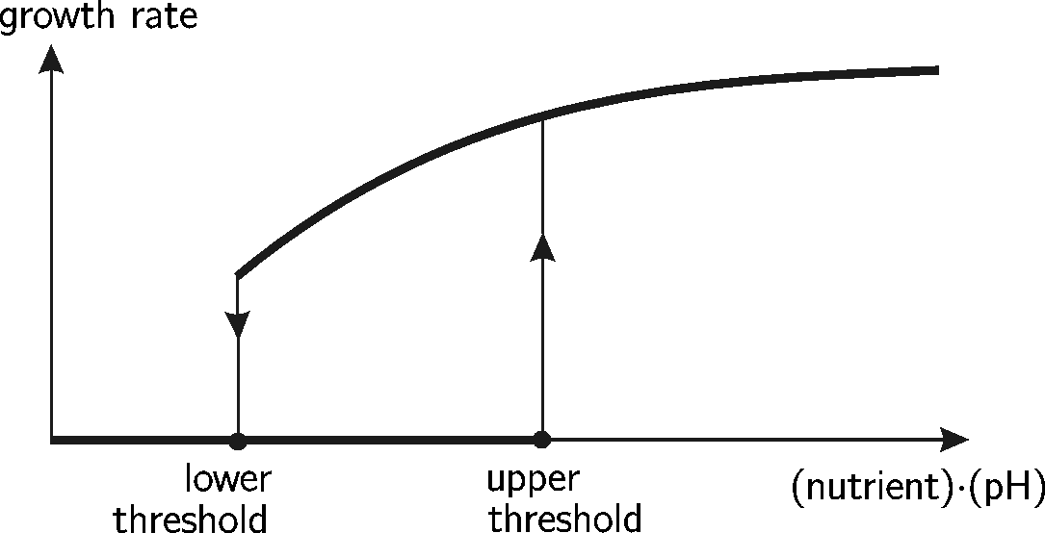
Example: metabolic processes
F. C. Hoppensteadt, W. Jäger, 1980: Colony of bacteria on a Petri plate with jelly
Density of bacteria after growth has stopped:
the more the better
bacteria growth
nutrient, pH
Hysteresis
Spatially distributed hysteresis

Slide 3
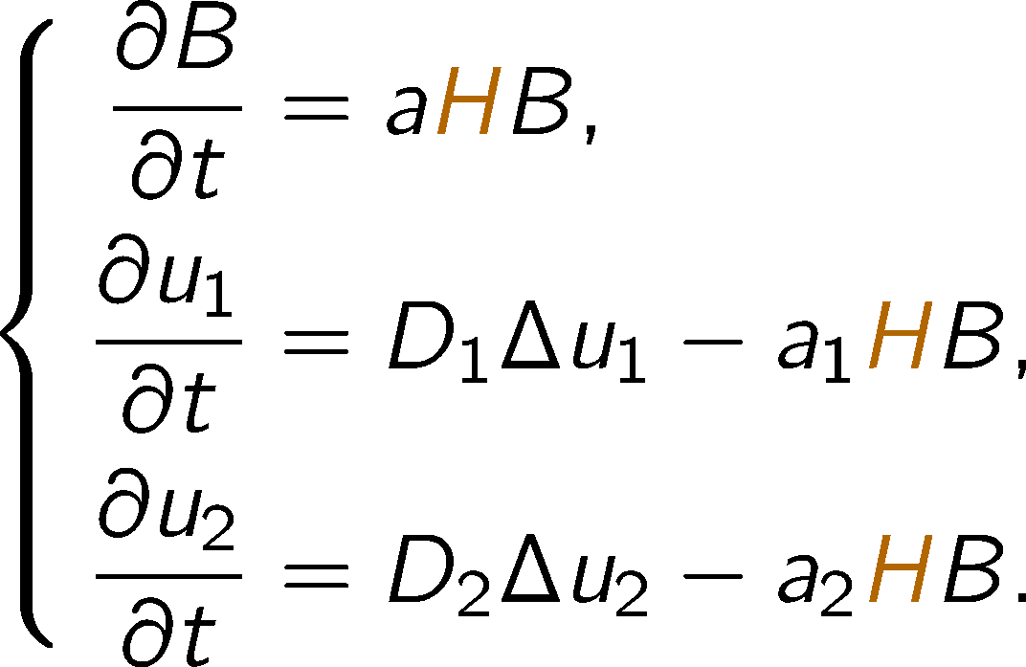
Reaction-diffusion equations
Spatially distributed hysteresis

Slide 4
Historical remarks
F. C. Hoppensteadt, W. Jäger, 1980, 1984 numerical simulations (bacteria model)
A. Marciniak-Czochra, 2006 numerical simulations (developmental biology)
A. Visintin, 1986 existence: multi-valued hysteresis (simplified bacteria)
T. Aiki, J. Kopfová, 2006 existence: multi-valued hysteresis (“full” bacteria)
H. Alt, 1985 (but after A. Visintin) existence: single-valued relay in
A. Il’in, 2011 existence: eq. is not valid on the thresholds
Open questions: uniqueness, mechanisms of pattern formation

Slide 5
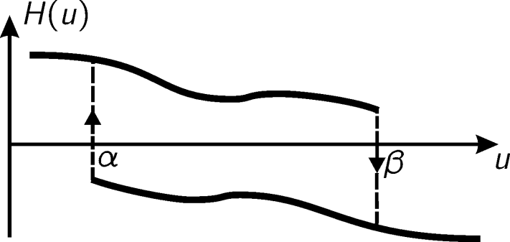
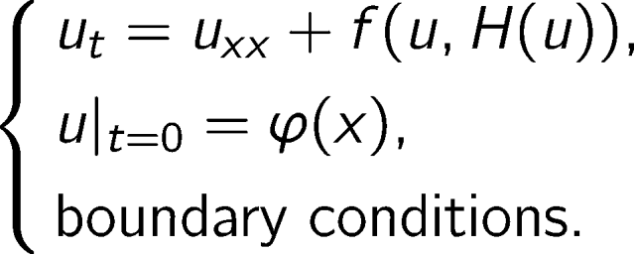
Reaction-diffusion equations
For simplicity: 1 spatial dimension, scalar equation
In general: n spatial dimensions, systems of equations, hysteresis depending on vector-valued functions
Assumptions

Slide 6
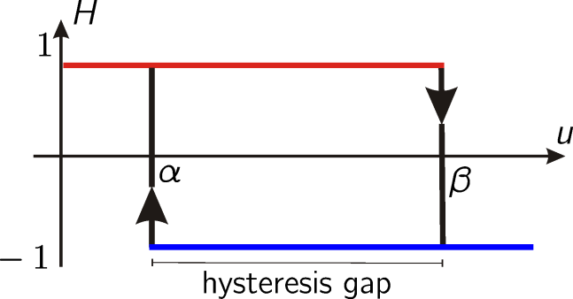
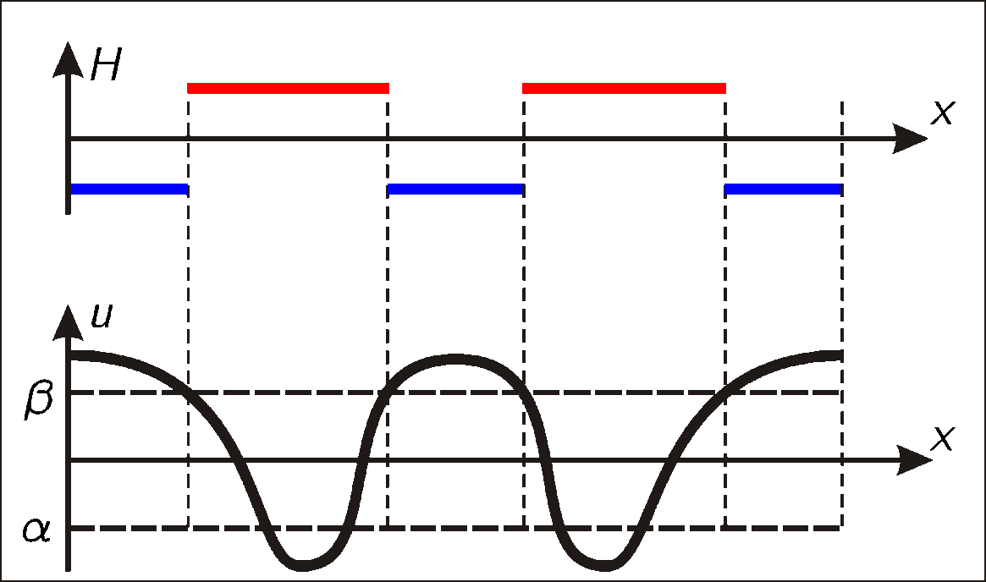
Main assumption for initial data

Slide 7
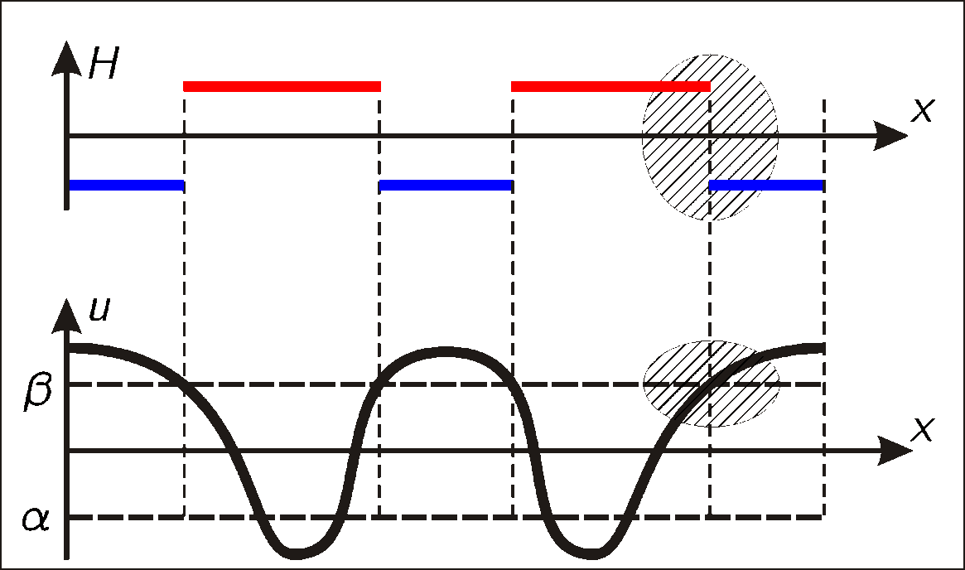
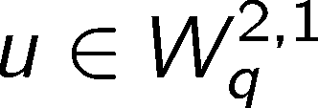
Existence and uniqueness
Theorem (Gurevich, Shamin, Tikhomirov – 2011).
Solution of
exists and is unique for some T
can be continued as long as it remains spatially transverse
continuously depends on initial data.
Nontransversalities in time are still possible.

Slide 8
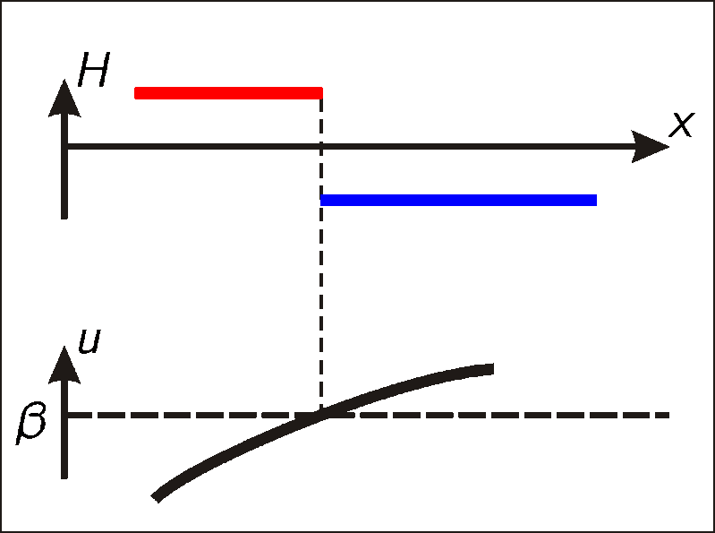
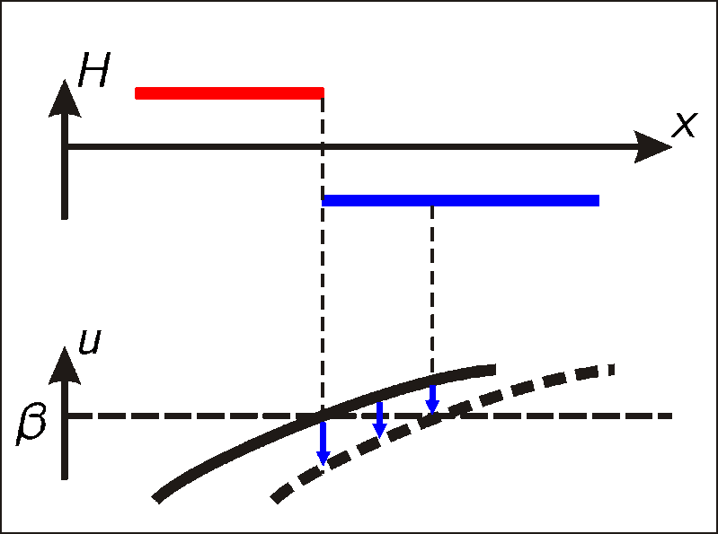
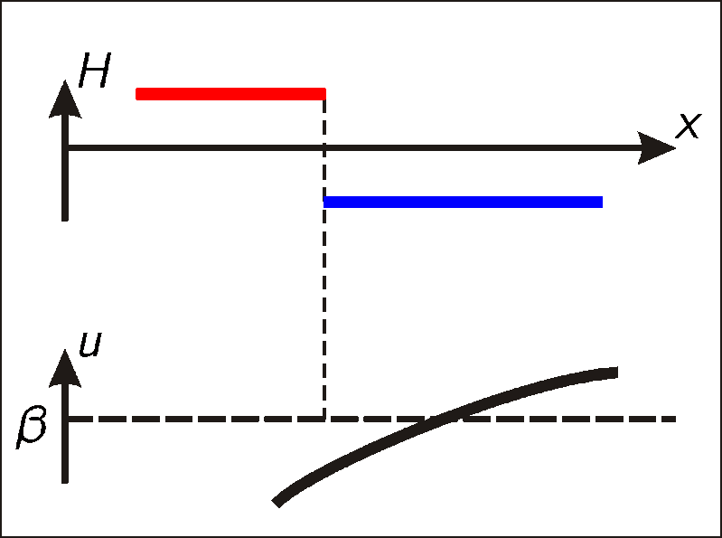
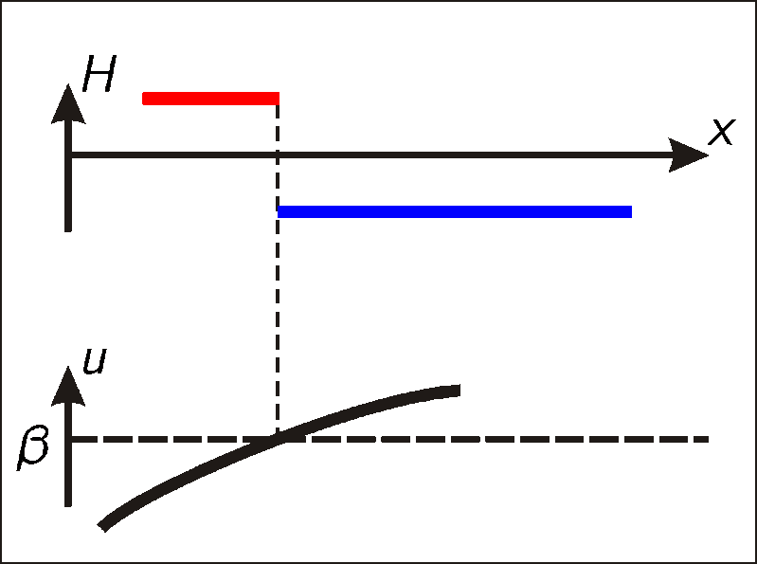
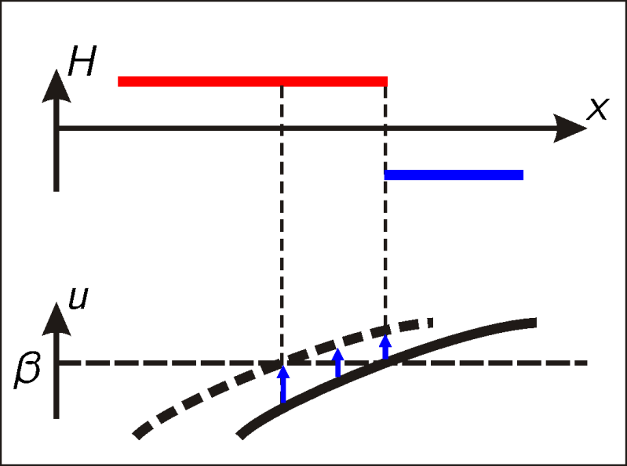
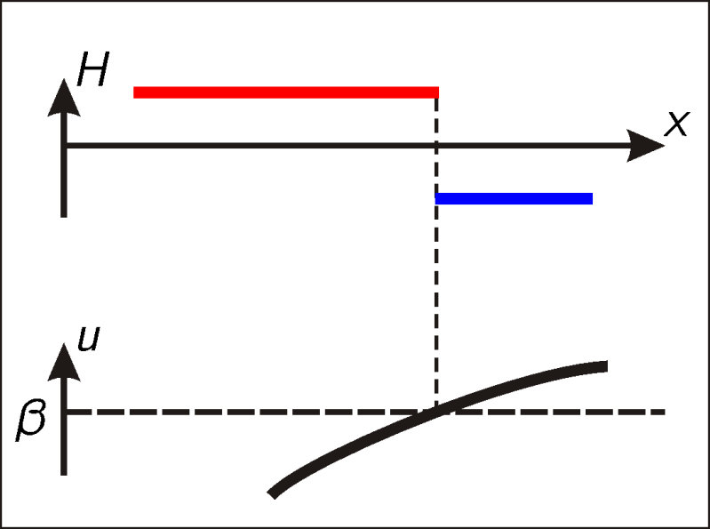
Free boundary
Theorem (Gurevich, Shamin, Tikhomirov – 2011).
Solution
exists and is unique for some T
can be continued as long as it remains spatially transverse
continuously depends on initial data.
Nontransversalities in time are still possible.
Theorem (Gurevich, Shamin, Tikhomirov – 2011).
Solution of
exists and is unique for some T
can be continued as long as it remains spatially transverse
continuously depends on initial data.
Nontransversalities in time are still possible.

Slide 9
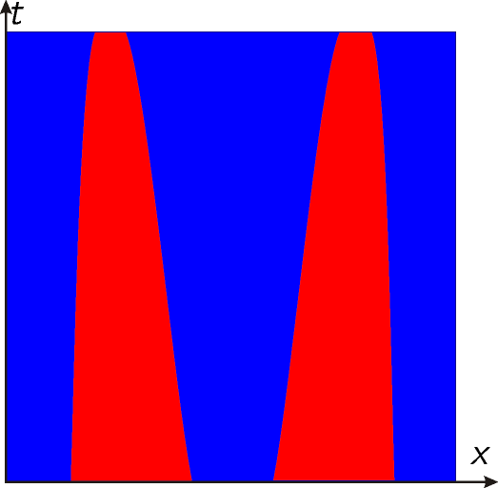
Hysteresis pattern
Profile of solution evolves:
Hysteresis pattern due to free boundaries:

Slide 10
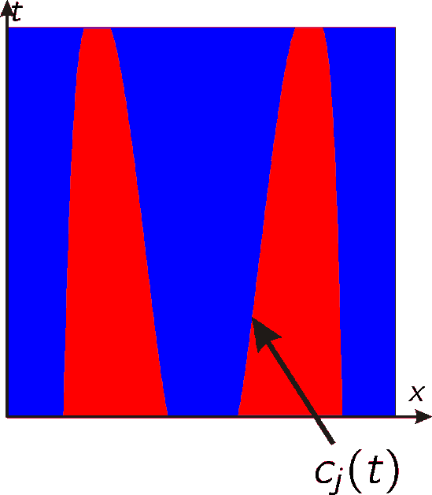
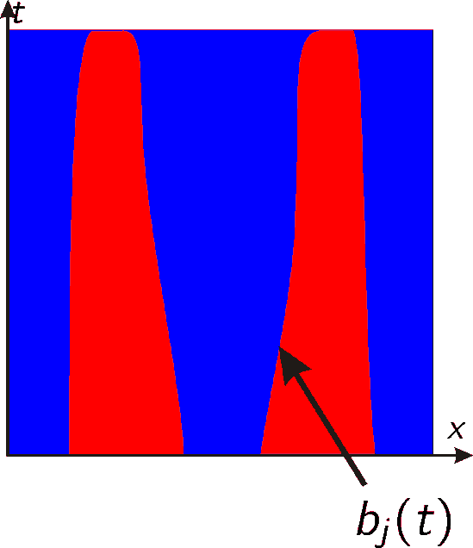
Existence: sketch of proof
Fix pattern: continuous functions
Define: according to the picture
Solve:
determines hysteresis H(u), hence new hysteresis pattern
New topology coincides with the original one for small T. The map is continuous and compact in
Schauder fixed-point theorem

Slide 11
Uniqueness: sketch of proof (1D)

Slide 12
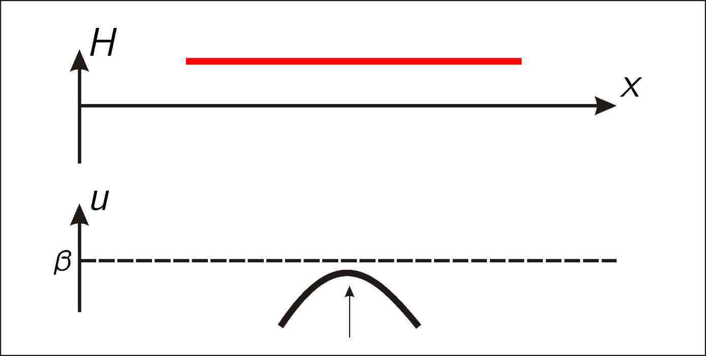
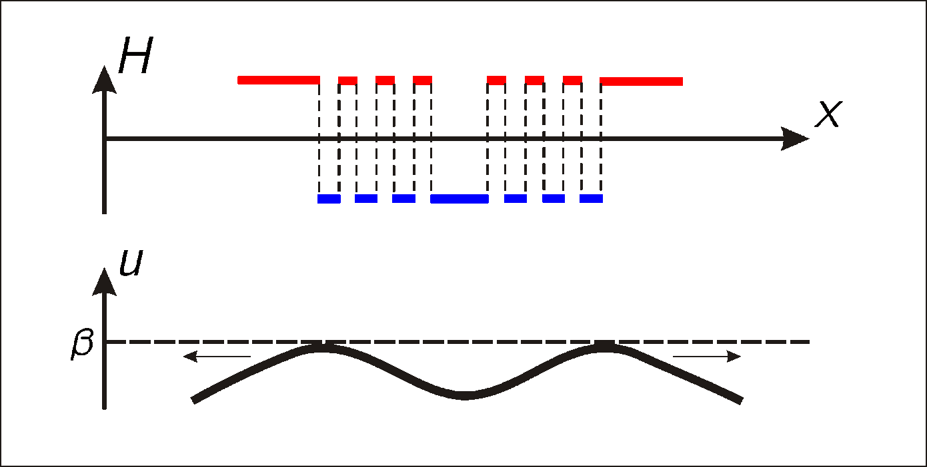
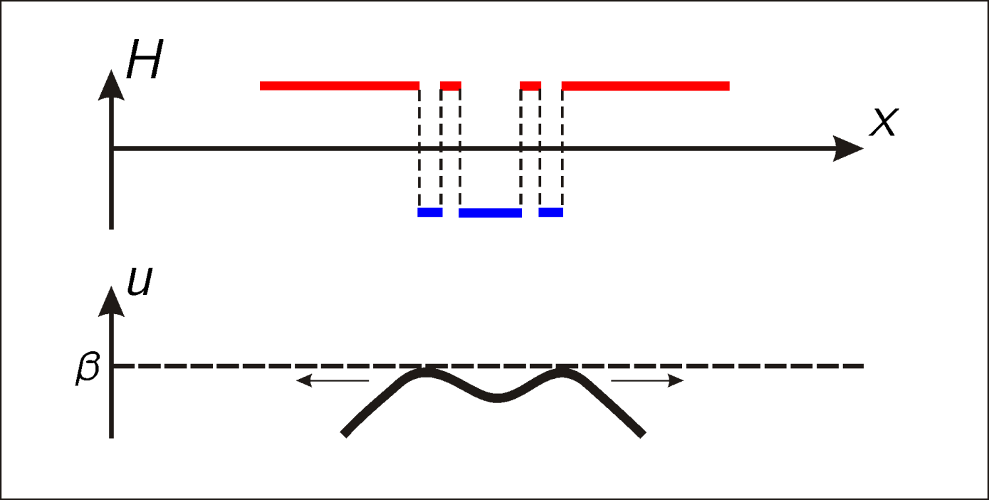
Nontransversality: rattling

Slide 13
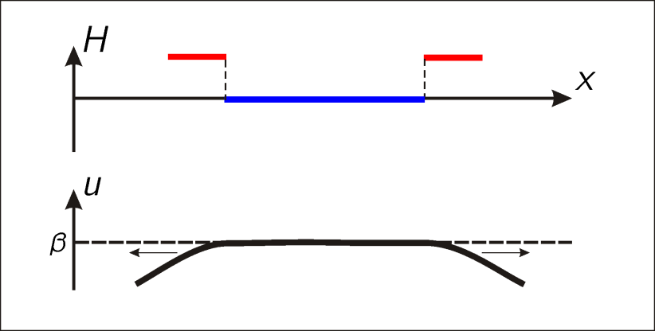
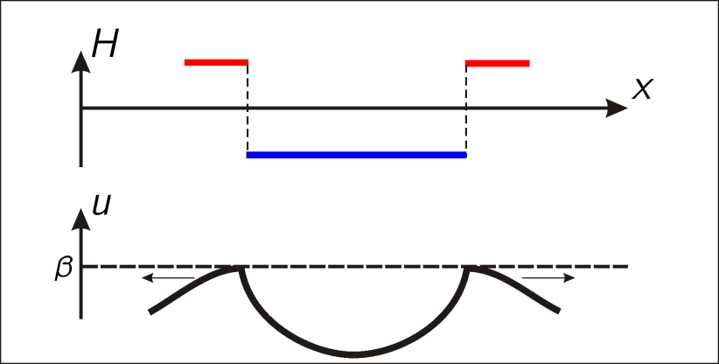
Nontransversality: no rattling
H. Alt, 1986:
Questions: uniqueness, detachment, physical relevance
A. Il’in, 2011:
Questions: uniqueness, physical relevance
Regularization of hysteresis: Preisach or slow-fast dynamics?
is not valid on the threshold

Slide 14
Thank you
for your attention!

